Slide 1








Healthcare Industry

Slide 2







Team Meambers
S-L1
Mr.L.K.H.S.D.K. Silva
20220761
Mr. M.S. Ammar
20221312
Mr. M.I.M. Usman
20221300
Mr. M.M.A.U. Sandasara
20221297
Mr. S.Suwagath
20220756

Slide 3



CONTENT
1. Introduction to Healthcare Industry.
1.1 Significance of Healthcare.
2. Role of Information Systems and its Significance in Healthcare.
2.1 Significance of Health Information Systems.
2.2 Role of Health Information Systems.
3. Information Systems Used in Healthcare Industry.
3.1 EHR and EMR.
3.2 Systems used in Electronic Health Record (EHR)
3.3 Advantage and Disadvantages of (EHR).
4. Past, Present and Future of Health Information Systems.
5. Summary.

Slide 4



1.Introduction to Healthcare Industry.
The healthcare sector consists of businesses that provide medical services, manufacture medical equipment or drugs, provide medical insurance, or otherwise facilitate the provision of healthcare to patients.

Slide 5

1.1 Significance of Healthcare
White
Is the color of milk and fresh snow, the color produced by the combination of all the colors of the visible spectrum.
Black
Is the color of ebony and of outer space. It has been the symbolic color of elegance, solemnity and authority.

Slide 6

2. Role of Information Systems and its Significance in Healthcare.
Health information systems help gather, compile and analyze health data to help manage population health and reduce healthcare costs. Then the healthcare data analysis can improve patient care.
Collaborative care: Patients often need to treatments from different healthcare providers.

Slide 7

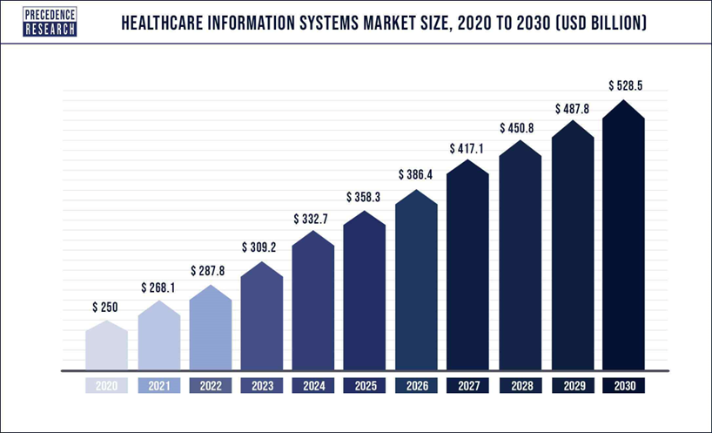
2.1 Significance of Health Information Systems.
A health information system enables health care organizations to collect, store, manage, analyze, and optimize patient treatment histories and other key data.
Doctors and nurses use health information systems to make data-driven decisions regarding various facets of patient care. For example, quick access to patient medical histories can bring previous treatments to light.
These systems also enable health care providers to easily get information about macro environments such as community health trends.

Slide 8
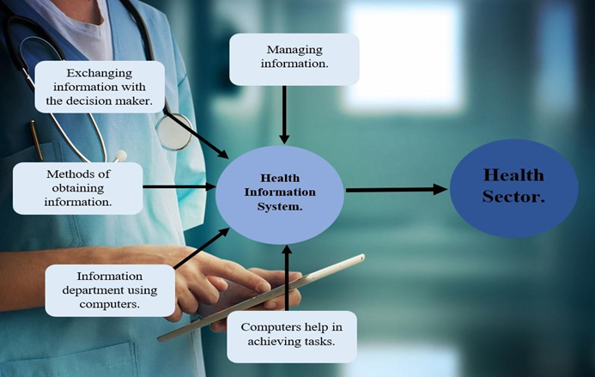
2.2 Role of Health Information Systems.
Data Analytics
Collaboration
Population Health Management
Cost Control

Slide 9


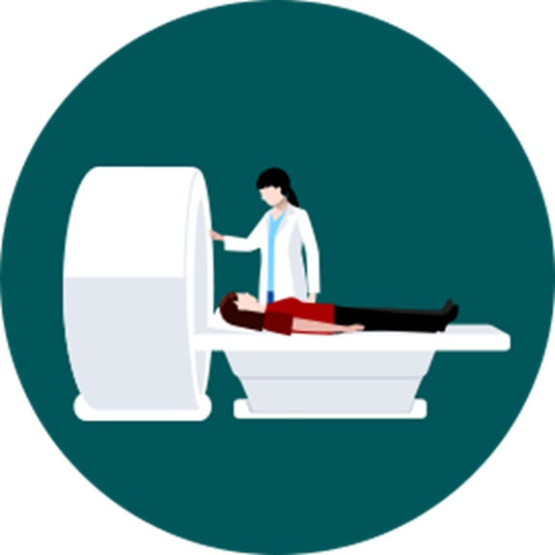
3. Information Systems Used in Healthcare Industry.
A health information system (HIS) refers to a system designed to manage healthcare data. This includes systems that collect, store, manage and transmit a patient's electronic medical record (EMR), a hospital's operational management or a system supporting healthcare policy decisions.

Slide 10
3.1 EHR and EMR.
EHRs | EMRs
A digital record of all patient health information. | A digital version of a patient chart.
Allows a patient’s medical information to move with them to other health care providers and specialists. | Patient record does not easily travel outside the practice and might need to be printed.
Accessed by any number of providers for decision making, diagnosis and care beyond one provider’s office. | Mainly used by a provider for diagnosis, treatment and care.

Slide 11


3.2 Systems used in Electronic Health Record (EHR)
Physician-hosted system
Subsidized remote system
Dedicated remote system
Cloud remote system

Slide 12


3.3 Advantage and Disadvantages of (EHR).
Advantages
Less Paperwork.
Improved Care
Secured Sharing
Disadvantages
Implementation
Inaccurate Data
Frightening Patients Needlessly

Slide 13

4. Past, Present and Future of Healthcare Information Systems.
Past
Present
Future

Slide 14






Summary
Information systems used in the healthcare industry makes sure that all healthcare provides gets trends easily in order to be updated.
The Efforts made to maintain or restore physical, mental, or emotional well-being especially by trained and licensed professionals and work put in providing primary care, secondary care, tertiary care.
EMR and EHR are some of information system used in the healthcare industry.
Healthcare industry is one of the largest and the fastest growing industries is the world.

Slide 15

Q&A

